Slide 1
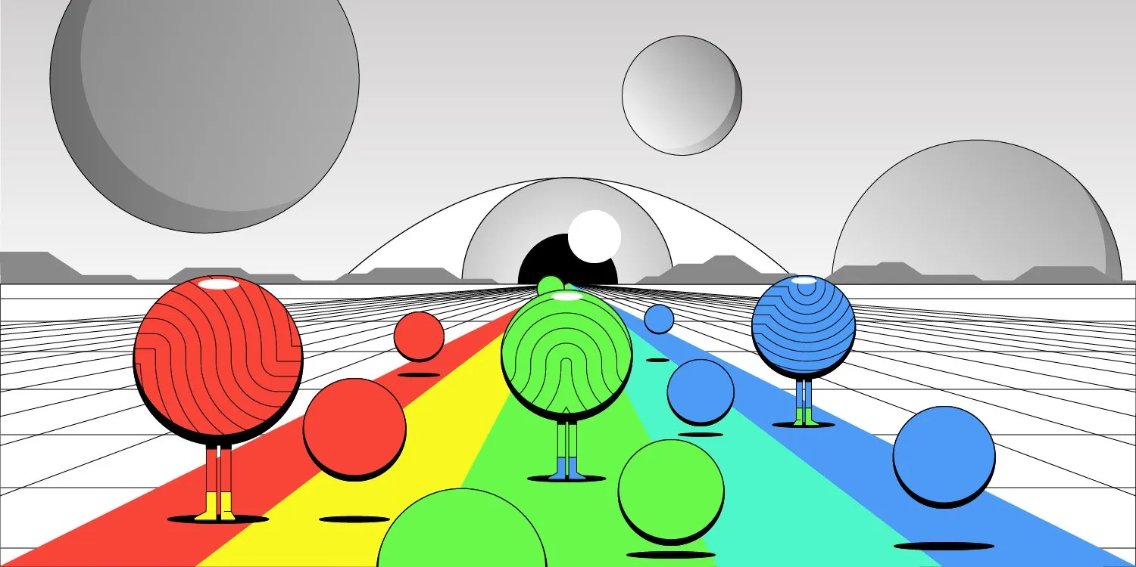
Quantum Dots & QD-OLED Display
Presented By
Afrim Hossen Khan
ID : 232-35-

Slide 2
How Dose Quantum Dots Work
e
e
e

Slide 3
Quantum Dot
Different Semiconductor
Semiconductor
Cristal form of two Semiconductors
Generated island or QD
Cover of led

Slide 4

Changing Color of Quantum Dots
6
$$n$$
5
Excited state
4
3
2
Ground state
1

Slide 5
W-OLED vs QD-OLED
QD-OLED
W-OLED
Blue Light
Blue Light
Created white light
TV SCREEN
Green QD
Red QD
GRB filter
White light
Blue Light sending wave
Yellow Phosphorus

Slide 6
Thank You

